Slide 1
Hostel Management System

Slide 2
Introduction
This solution is developed on the plight of the hostel management team, through this they cannot require so efficient person to handle and manage the affairs of the students in the hostel, all you need to do is to login as administrator and you can see the information of all the students who have obtained and registered their hostel form, click verify to ascertain their eligibility and allocate them to the available hostel.
Identification of the problems of the existing hostel management leads to the development of computerized solution that will be compatible to the existing hostel management with the solution which is more users friendly and more GUI oriented. We can improve the efficiency of the hostel management, thus overcome the drawbacks of the existing management.

Slide 3
Overview
The hostel management system is web based software to provide college students accommodation to the university hostel more efficiently. This project also keeps details of the hostellers and applied students. It is headed by Admin. He will be the administrator. This document is intended to minimize human works and make hostel allocation an easier job for students and hostel authorities by providing online application for hostel, automatically select the students from the waiting list and mess calculation, complaint registration, notice board etc.

Slide 4
Reason for choosing this project
This Hostel Management System is developed in favor of the hostel management team which helps them to save the records of the students about their rooms and other things. It helps them from the manual work from which it is very difficult to find the record of the students and the information about those ones who had left the hostel years before

Slide 5
Limitation Of Current System
Yes there is a limitation of this project. The main Limitation is this project can’t input a huge amount of student data at a same time. On the other hand this project is online based and build within PHP based. So only this system Run when you in online.

Slide 6
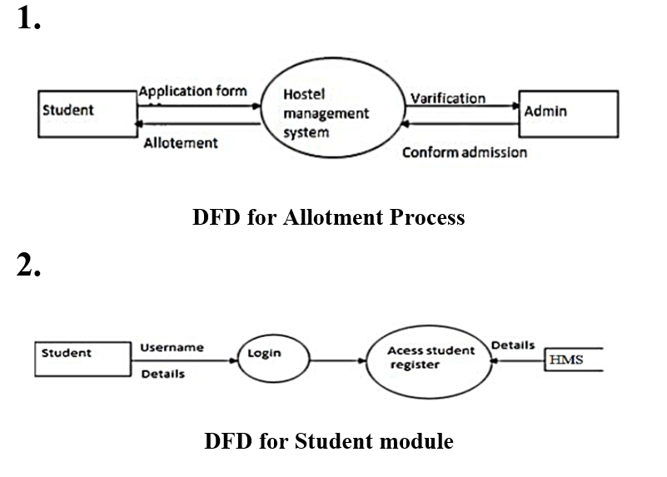
Context Data Flow Diagram

Slide 7
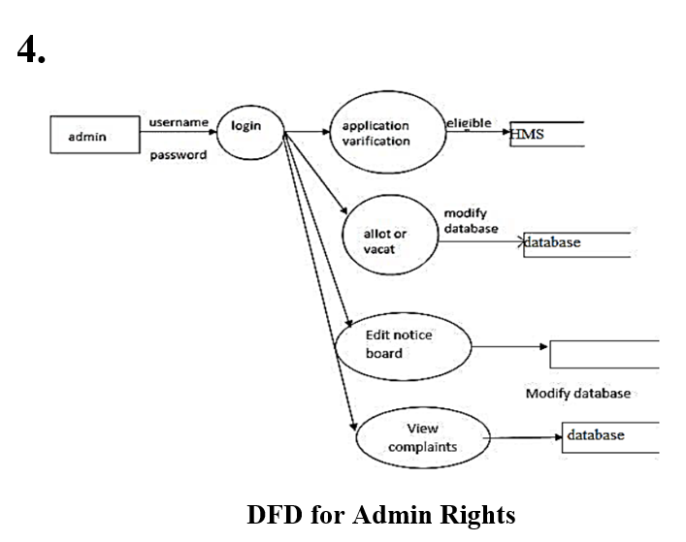
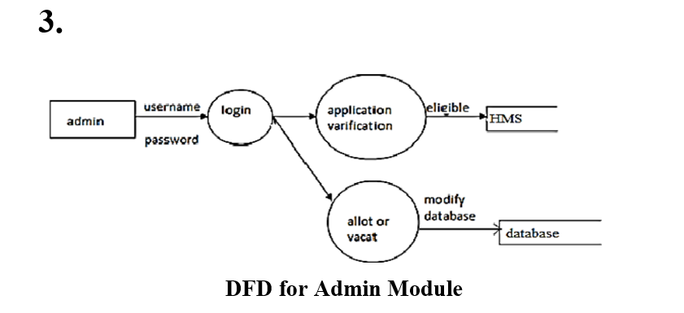

Slide 8
